Slide 1
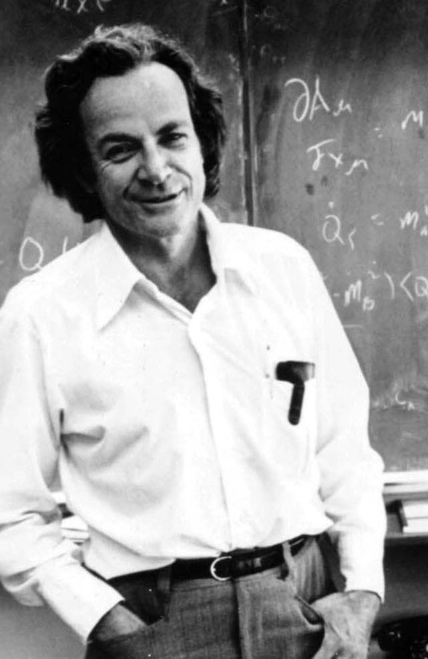
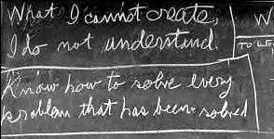

Slide 2
The Hasty group’s (original) synthetic negative autoregulation and relaxation oscillators

Slide 3
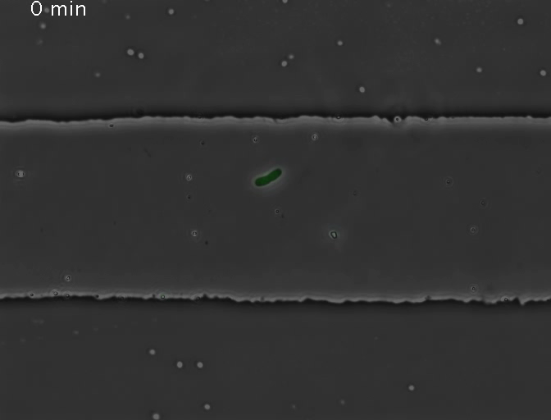
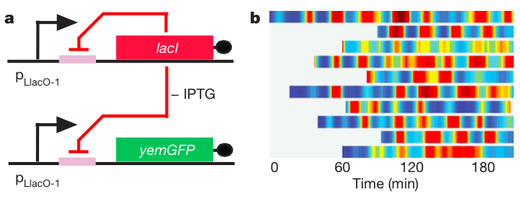
A simple negative feedback loop

Slide 4
A simple negative feedback loop

Slide 5
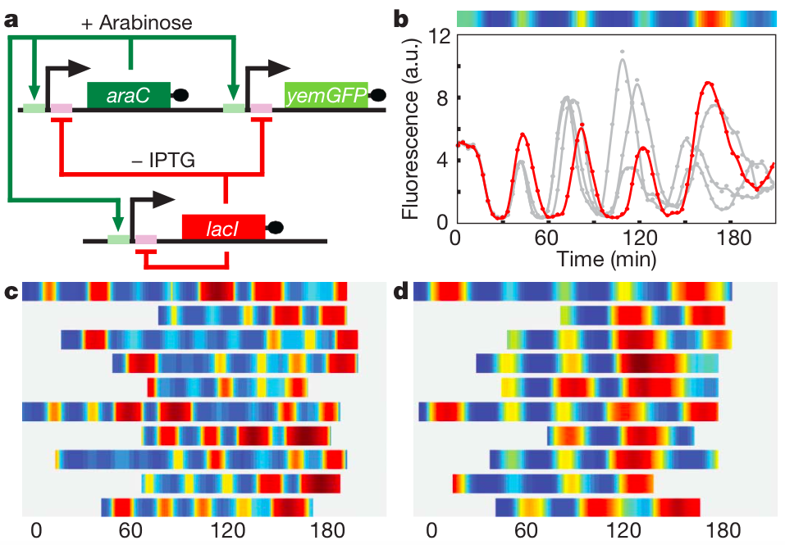
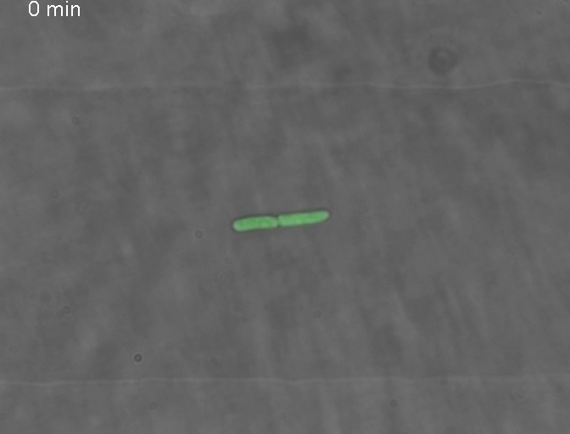
Stricker et al. synthetic relaxation oscillator

Slide 6
Stricker et al. synthetic relaxation oscillator

Slide 7
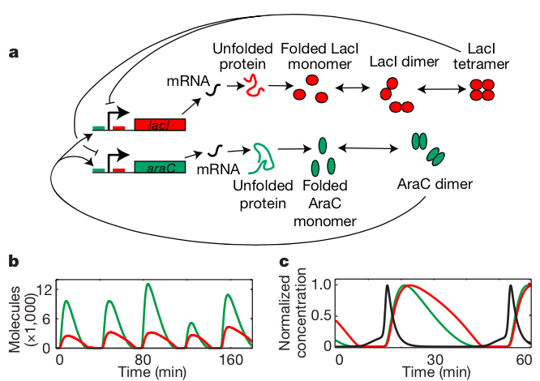
Stochastic vs. deterministic modeling

Slide 8
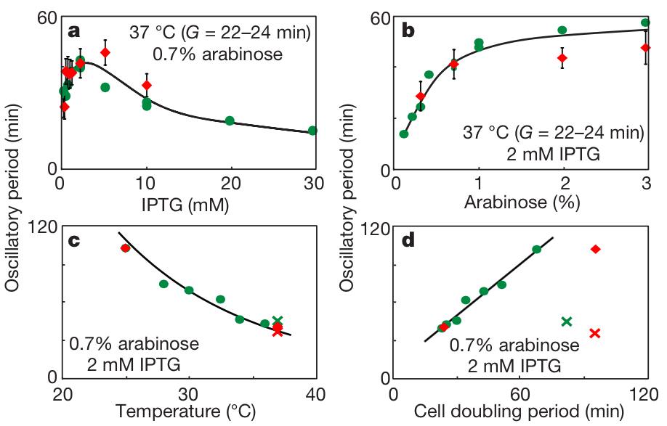
Tunability and robustness

Slide 9
Synthetic temperature compensation with temperature-sensitive mutants

Slide 10
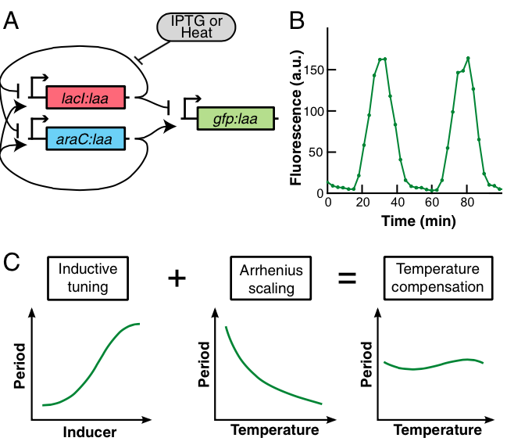
Hussain et al. oscillator (temperature compensation)

Slide 11
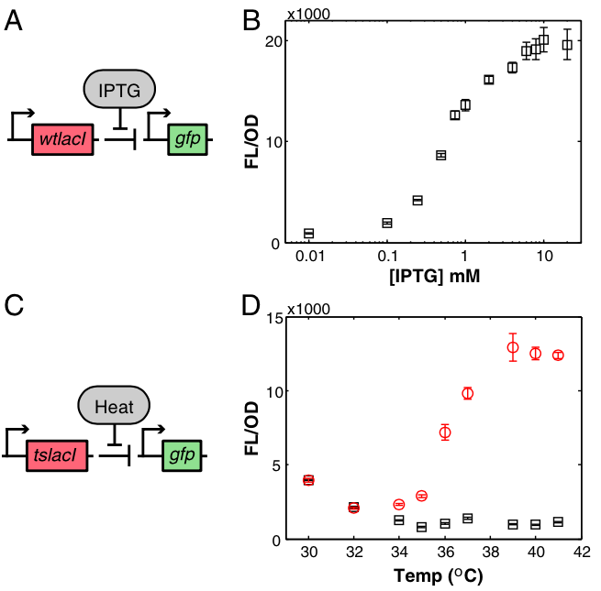
Hussain et al. oscillator (temperature compensation)

Slide 12
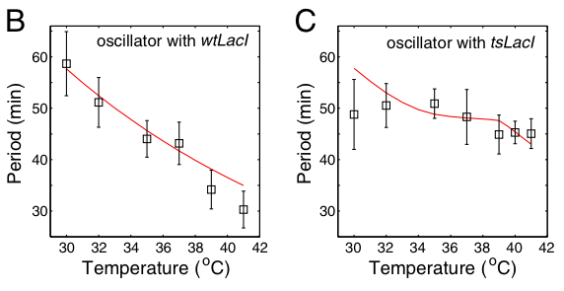
Hussain et al. oscillator (temperature compensation)

Slide 13
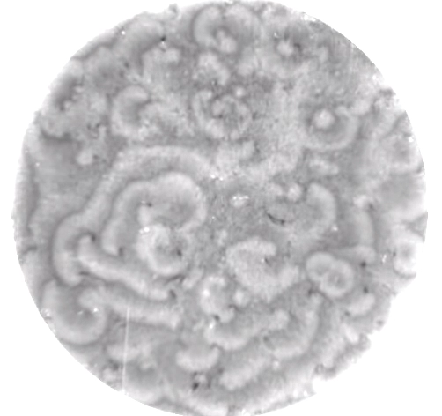
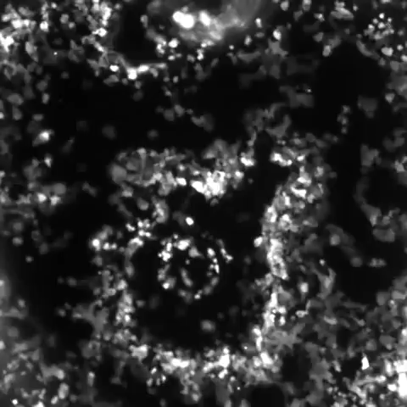
Consistency through coupling

Slide 14
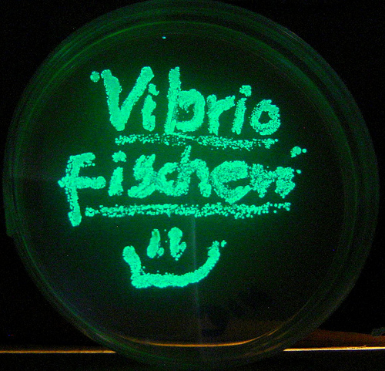
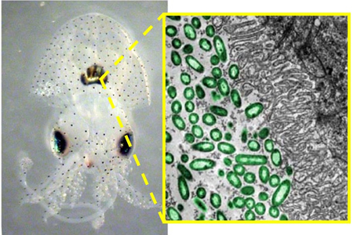
Vibrio and the bobtail squid

Slide 15
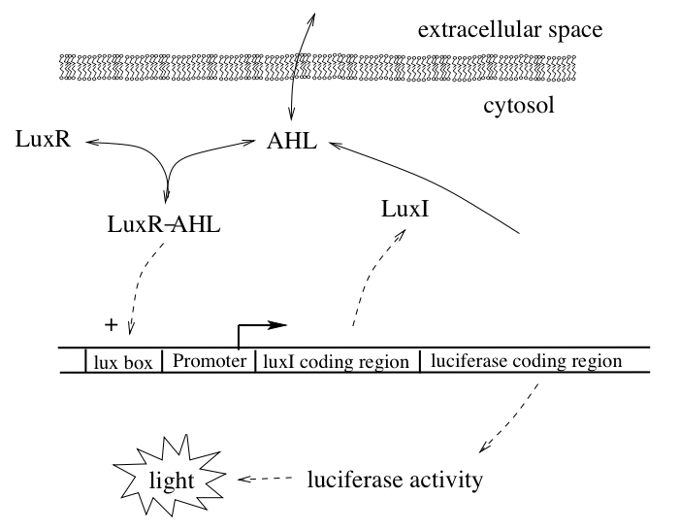
Quorum sensing

Slide 16
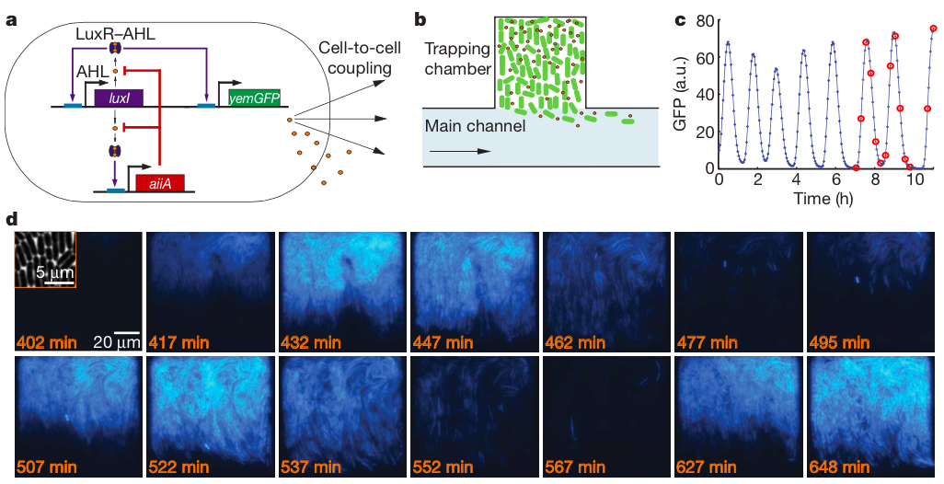
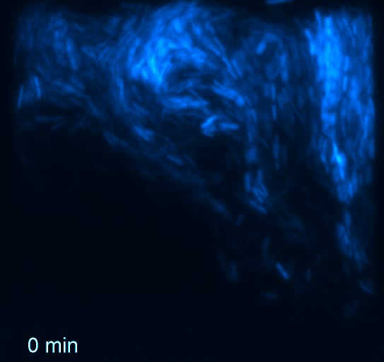
Danino et al. quorum sensing oscillator

Slide 17
Danino et al. quorum sensing oscillator

Slide 18
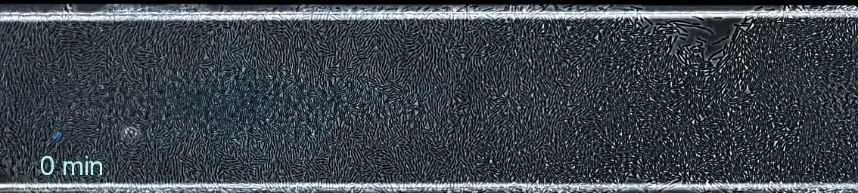
Waves in a larger population

Slide 19
Why is period so variable in these models?

Slide 20
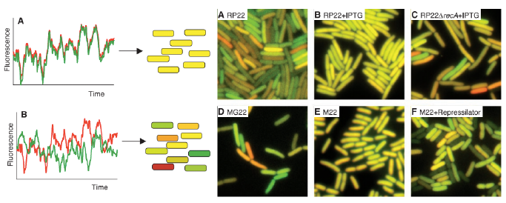
Intrinsic vs. extrinsic noise

Slide 21
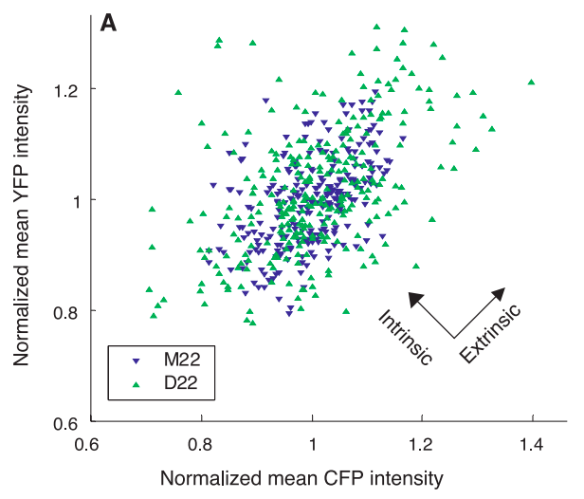
Intrinsic vs. extrinsic noise

Slide 22
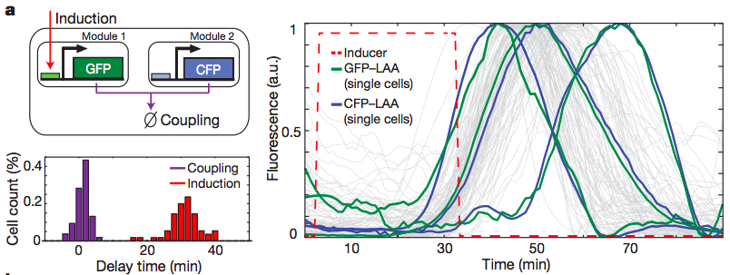
Prindle et al. degradation-mediated coupling

Slide 23
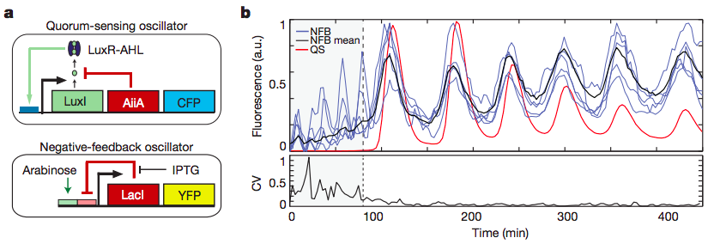
Prindle et al. coupled oscillators

Slide 24
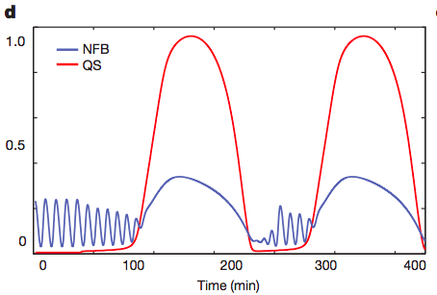
Degradation-mediated coupling despite differences in intrinsic period

Slide 25
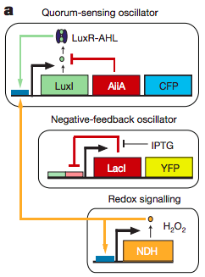
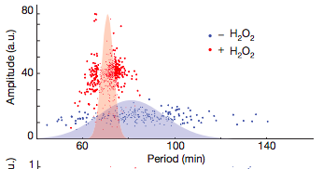
Better coupling through increased load on protein degradation system

Slide 26
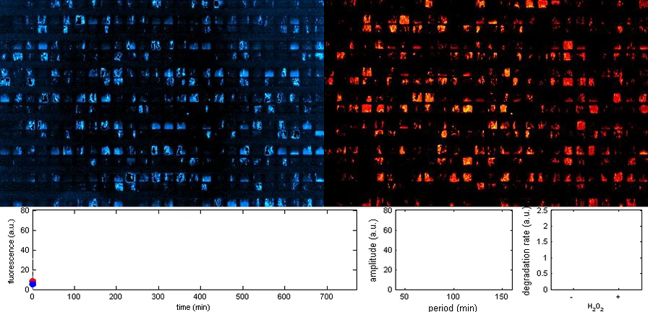
Better coupling through increased load on protein degradation system

